Slide 1

Chapter 7
Sales Leadership, Management, and Supervision

Slide 2
Learning Objectives
Distinguish between salesforce leadership, management, and supervision.
Discuss the importance of situational factors in determining the most effective sales leadership approaches.
Explain how leadership style approaches contribute to contemporary sales leadership.

Slide 3
Learning Objectives
Discuss six bases of power that affect leadership.
Explain five influential strategies used in leadership.
Discuss issues related to coaching salespeople, conducting sales meetings, and promoting ethical behavior.

Slide 4

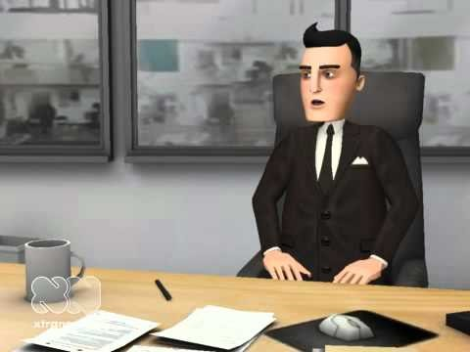
Is This Sales Leadership?
1:32
Notes:
https://www.youtube.com/watch?v=YHsiEJsmUN0&ab_channel=TheBrutalTruthSalesPodcast

Slide 5
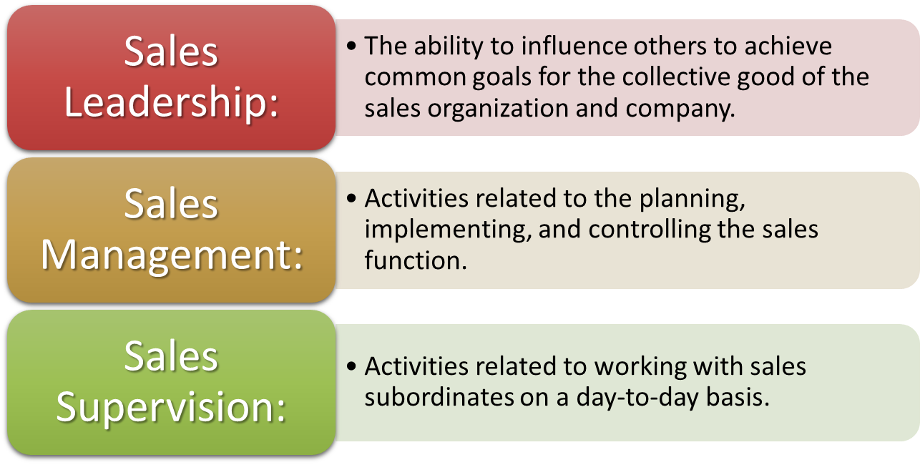
Sales Leadership, Sales Management, and Sales Supervision
Activities related to planning,
implementing, and controlling the sales
function.
Notes:
2
Although the terms leadership, management, and supervision are often used inter-changeably, we think it is important to differentiate among them.
Sales leadership includes the leadership activities of senior sales leaders that are directed at the entire sales organization or large subunits, and focus on creating the appropriate direction, environment, and alignment within the sales organization.

Slide 6
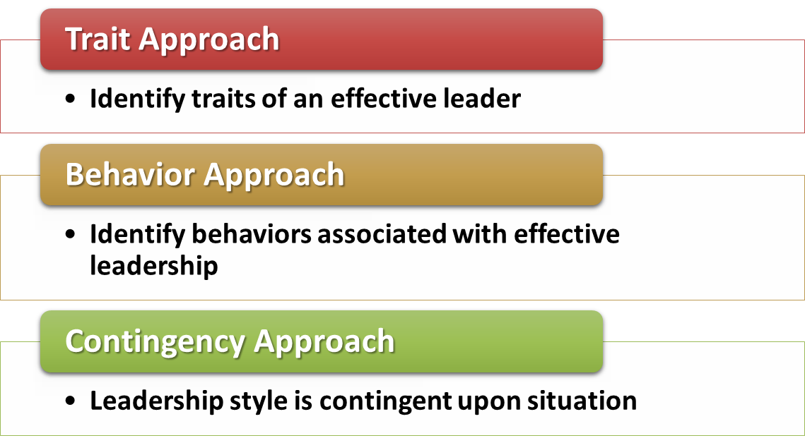
Situational Sales Leadership Perspectives
e.g., tall, high IQ
e.g., empathetic, good communicator
(Next slide)
Notes:
8

Slide 7
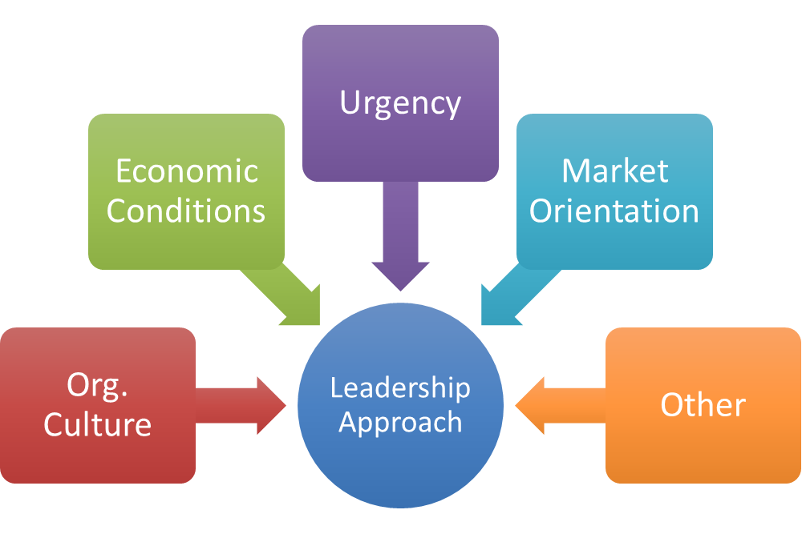
Leadership Approaches – Contingent Upon Situational Factors

Slide 8
Important Sales Leadership Skills
High performance sales leaders have the ability to
manage both one’s own and others’ emotions (i.e., high emotional intelligence).
communicate effectively by listening and sharing information.
work one-on-one with salespeople to help them improve (i.e., coaching skill).
set clear performance expectations and hold salespeople accountable.
solve problems and resolve conflicts.
engage and motivate salespeople to take ownership of expected performance outcomes.
strategize, plan and execute, including challenging salespeople to develop and execute effective sales strategies.
use technology to mine and analyze data.
prioritize and effectively manage one’s time.
build trust with salespeople through honesty and integrity.
Notes:
7

Slide 9
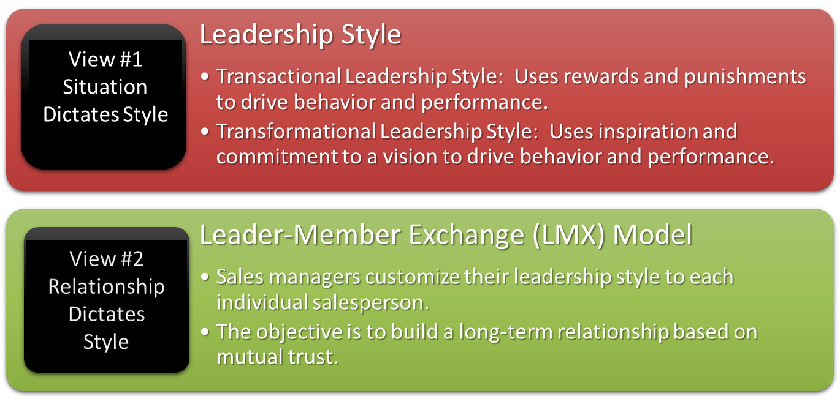
Leadership Styles & Relationships
Notes:
6

Slide 10

Transformational Leadership
What is Transformational Leadership - Irina Ketkin 3:02
Notes:
https://www.youtube.com/watch?v=XWVwFVgA4b4&ab_channel=BigThink
https://www.youtube.com/watch?v=UZTyvbmW92M&t=256s&ab_channel=MarcYu

Slide 11
What do you think?
Think about the different types of managers you have experienced. Discuss the characteristics of those considered "good" managers, the type of management style used, the power bases and influence strategies they used, and what made them a good manager.
Do the same for those considered “poor” managers.

Slide 12

Thoughts on Leadership
Jordan Peterson’s guide to leadership | Big Think 6:54
Notes:
https://www.youtube.com/watch?v=XWVwFVgA4b4&ab_channel=BigThink
https://www.youtube.com/watch?v=UZTyvbmW92M&t=256s&ab_channel=MarcYu

Slide 13

Thoughts on Leadership
Leadership Explained in 5 minutes by Simon Sinek 5:24
Notes:
https://www.youtube.com/watch?v=XWVwFVgA4b4&ab_channel=BigThink
https://www.youtube.com/watch?v=UZTyvbmW92M&t=256s&ab_channel=MarcYu

Slide 14

Power and Leadership
Power is the ability to produce an effect.
One’s perception of power determines the effect of power in an interpersonal relationship.
Effective leaders know when to exercise each of the five sources of power (including in combination).
Effective leaders tend to use more expert and referent power bases.
Salespeople may at times have more power than their managers.
Notes:
7

Slide 15
Power and Leadership
EXPERT POWER ‑ This power is based on the belief that a person has valuable knowledge or skills in a given area.
REFERENT POWER ‑ This power is based on the attractiveness of one party to another. It may arise from friendship, role modeling, or perceived similarity of personal background or viewpoints.
LEGITIMATE POWER ‑ This power is associated with the right to be a leader, usually as a result of designated organizational roles.
REWARD POWER ‑ A power stemming from the ability of one party to reward the other party for a designated action.
COERCIVE POWER ‑ Power based on a belief that one party can remove rewards and provide punishment to affect behavior.
INFORMATIONAL POWER – Power based on the belief that an individual has control over valuable information that others need or want. The threat to withhold the information or the offer to share it gives the leader power.

Slide 16
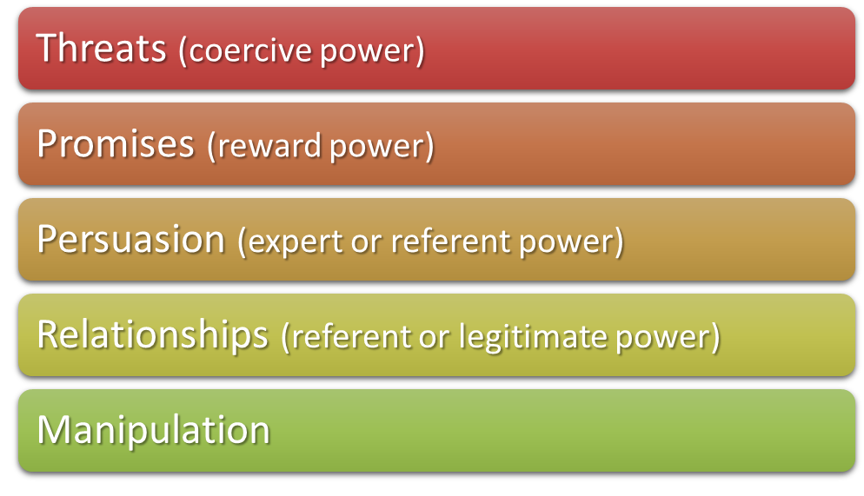

Sales Leadership Influence Strategies
Typically “last resort”
Influence based on a promise
Convincing of the importance
Trust; friendship; respect
Truth twisting; behind the scenes
Notes:
12
Glengarry Glen Ross (Movie) Speech: WARNING / ADVISORY: Contains foul and offensive language that may be upsetting to some viewers.
https://youtu.be/elrnAl6ygeM?si=FBnue9mJJHKLoCgb

Slide 17
Sales Leadership Influence Strategies
THREATS This influence strategy is based on threats. A manager would specify both the desired behavior and the punishment that would be forthcoming if the behavior is not achieved.
PROMISES This influence strategy utilizes reward power, the manager's ability to reward for a designated action.
PERSUASION A sales manager's persuasive messages must be both rational and reasonable and require both time and skill to be effective. The sales manager needs both expert and referent power bases in order to be persuasive.
RELATIONSHIPS When a sales manager is personally liked, trusted, admired, or respected by someone, that person is willing to do what the manager asks because of this relationship. Also, the position as manager will influence others to do as asked without the use of other types of influence mechanisms.
MANIPULATION This influence strategy does not involve direct communication with the target of influence. Instead, the sales manager uses circumstances to influence behavior.

Slide 18
Power and Influence in Action
What kind of power and influence strategies did your good manager use?
What kind of power and influence strategies did your bad manager use?

Slide 19
How Sales Managers Can Develop Power
Listen to your sales team’s wants, needs, and dreams and help them achieve them.
Be versatile and adapt to different situations.
Discover how your behavior differs when you are busy and avoid any of these behaviors that are negative.
Learn what invigorates other people and adapt how you work with them to influence that energy.
Earn others’ trust by being authentic.
Develop strong relationships with important people in your organization; develop your political skill.
Demonstrate empathy towards others.
Exhibit energy and enthusiasm.
Secure support of upper management for sales management programs and activities.
Use one-on-one meetings to motivate salespeople.
Increase your knowledge to become an expert.
Notes:
Day 2 Starts Here

Slide 20
An Ethical Dilemma
You are a field sales manager with 12 salespeople on your team. All of your salespeople are performing well, except for one. You have tried different leadership styles, relationship approaches, and influence strategies, but this problem salesperson has not responded to any of
your leadership approaches. Feeling desperate, you are thinking about telling this problem salesperson that you are going to have to terminate one salesperson from your team, because your firm wants to reduce the size of its salesforce. The top candidates for termination are the problem salesperson and another salesperson who is currently performing better than the problem salesperson. Although none of this is true, you think it might motivate the problem salesperson to work harder and perform better. What would you do?
Tell the problem salesperson that you need to terminate one salesperson and that he/she is one of the top two candidates who will be let go unless there is an improvement in his/her performance.
Tell the problem salesperson that you will give him/her a bonus if his/her performance improves over the next 30 days.
Ask the problem salesperson how you can help him/her improve his/her sales performance.
Take some other action not listed here.

Slide 21

Sales Leadership Communication
Tools
Cell Phones
e-Mail
Texting
Voice Mail
Web Conferencing
LinkedIn
Twitter/X
Instant Messaging
Important to understand the best methods and the appropriate content and frequency.

Slide 22
Tips for More Effective Communication
Know your audience.
Begin with a story (especially about people) and use statistics and visuals to support it. (next slide)
Build suspense in your communication but be concise and on point.
Use alliteration repetition (“good to great”) & rhythm to add interest when speaking.
Apply powerful quotes to help effectively convey your message.
Break down complicated ideas into small parts.
Where appropriate, use “we” rather than “I” and “you” to promote inclusion.
Be honest in conveying your message and work toward developing trust. Be positive but do not try to hide negative or bad news.
Take a helpful approach when communicating by asking the receiver how you can help him or her.
Be consistent in your tone across your communications.
Be authentic in your communication.
Be an attentive listener.
Use multiple channels to communicate (e.g., in-person, email, phone, etc.).

Slide 23

The Power of Stories in Leadership
4:31

Slide 24

Coaching
Working directly with salespeople to help them develop professionally, plan and execute sales strategies of specific customers, and improve all aspects of the sales process.
Notes:
14

Slide 25
Coaching Suggestions
Address only one or two problems at a time. First determine what might be causing a problem.
Provide clear expectations regarding behavior change and explain the consequences of failing to make a change.
Take a “we” approach instead of a “you” approach.
Instead of criticizing salespeople during coaching, help them improve by giving how-to advice.
Conversations should be interactive. Do not do all the talking. Insist that salespeople evaluate themselves.
Recognize differences in individual learning and communication styles among salespeople, be flexible, and respond appropriately.
Coordinate coaching with more formal sales training.
Encourage continual growth and improvement of salespeople.
Keep records of coaching sessions specifying corrective action to be taken, objectives of the coaching session, and a timetable for accomplishing the objective. Follow up to ensure objectives are accomplished.
Notes:
14

Slide 26
Coaching Areas of Focus (Slide 1 of 2)
Lead and Opportunity Coaching
Coaching focuses on understanding the customer, their business challenges and goals, your company’s value proposition, the customer’s buying center members and planned sales call objectives.
Funnel or Pipeline Coaching
Coaching focuses on forecasting opportunities, moving opportunities through the pipeline, looking at the number of opportunities and their time horizons, and prioritizing opportunities.

Slide 27
Coaching Areas of Focus (continued)
Skills and Behaviors Coaching
Coaching focuses on aligning the sales conversation with the customer’s path, uncovering customer needs, communicating and demonstrating value to the customer, and sales call skills such as rapport building, communication, use of visuals, closing, etc.
Account Coaching
Coaching focuses on understanding of accounts (e.g., their customers and markets) through research and analysis, threats and opportunities facing current accounts, and developing strategic opportunities within accounts.
Territory Coaching
Coaching focuses on identifying appropriate industries, verticals and customer segments, identifying important buyer roles within these, and planning how to improve and evaluate presence in these industries, verticals and segments.

Slide 28

Tips for Conducting an Effective Sales Meeting
Clearly establish the objective(s) of the meeting and its agenda.
Send out material to preview.
Share the meeting agenda ahead of time (“sell” the value of the meeting).
Keep the meeting as short as necessary to achieve the meeting’s objective(s).
Avoid covering too many issues.
Start and end the meeting on time.
Keep a consistent meeting schedule.
Be positive and forward-looking.
Recognize and praise performance.
Do not spend a lot of time dealing
with one person.
Allow time for salespeople to provide input and discuss issues.
Notes:
Finished Day 1 of Lecture here

Slide 29

Tips for Conducting an Effective Sales Meeting (continued)
Do not waste time on updates that could be provided by other means.
Implement activities that motivate and reward.
Provide an educational component to help improve salesperson skills.
Consider integrating other departments, such as marketing, into your meeting.
Provide “next steps” for anything decided upon at the meeting.

Slide 30
An Ethical Dilemma
You are a district sales manager for a rapidly growing solar power firm. There are seven salespeople in your district. Your company has set an aggressive district quota for this year. But, if your district exceeds this quota, you will receive a nice bonus, which is what you need to make the down payment on a house that you and your spouse want to purchase. As you review the performance of your district, it looks like you have a good chance of exceeding your district quota. Most of your sales reps are on track, but your star salesperson is 10 percent over quota already. It looks like this salesperson will ensure that your district quota is achieved, so you want to make sure you support this salesperson as much as you can throughout the remainder of the year. However, as you are reviewing recent expense reports, it becomes obvious to you that this star salesperson has been “padding” her expense report by claiming reimbursement for personal expenses. If true, this is a violation of your sales organization’s code of ethics and could warrant termination of the salesperson. What would you do?
Ignore the expense account padding. My star salesperson deserves a little extra for all she does for our organization.
Discuss this finding with my star salesperson to confirm that it is a violation. Tell her to stop
expensing personal items or she will be reprimanded.
Discuss this finding with my star salesperson to confirm that it is a violation. Tell her that
expensing personal items is against company policy and terminate her.
d. Do something else not listed here.

Slide 31
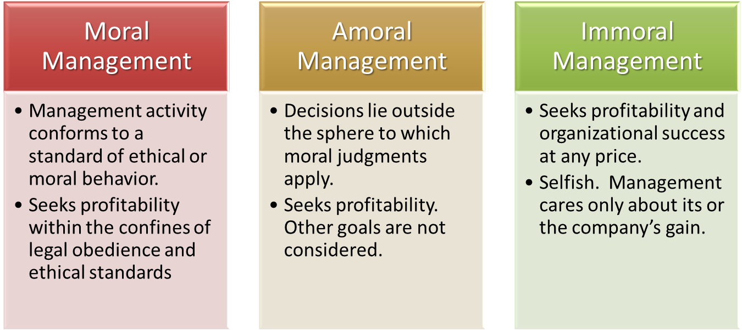
Approaches to Management Ethics
.
Notes:
The immoral management and amoral management approaches either disregard or do not consider the morality or ethical implications of management decisions and behavior. These approaches are likely to lead to some of the troubling unethical situations presented in the business or popular press in recent years.
Moral management, in contrast, actively incorporates moral considerations into all aspects of management and takes proactive measures to promote ethical behavior throughout the firm and sales organization. Many sales organizations have created a code of ethics to communicate the values and expected behaviors of salespeople and sales managers. Professional associations often have codes of ethics and require members to adhere to these standards of ethical behavior.

Slide 32

Ethical Leadership
Ethical Leaders:
Communicate an ethics and values
message
Role model acceptable ethical behavior
Listen to employees and consider their
best interests in making fair and
balanced decisions
Develop employee trust
Judge success by how results are obtained
Punish unethical behavior

Slide 33
Ethical Issues
Scenario 1
A sales-oriented organization frequently had contests to increase sales. The prizes offered included expense paid vacation trips to highly desirable locations, HDTVs, and other valuable merchandise.
Some of the sales personnel in the organization would hold orders and pressure reluctant buyers to "buy now" in order to maximize sales during the time period of the contest.

Slide 34
Ethical Issues
Scenario 2
The merchandise delivery from a direct sales organization to its sales representative usually takes three full days (Monday through Friday). If merchandise is shown and ordered by Wednesday, there is only about a 30% chance it will be received by Friday.
At a Wednesday showing, a sales representative promises that she can have the merchandise to a customer by Friday. The customer wants to wear it for a Friday night engagement and would probably not have purchased the item without the salesperson's assurance of a Friday delivery. However, she will probably accept the merchandise if it doesn't come until Monday.

Slide 35
Ethical Issues
Scenario 3
A direct sales organization has built a reputation for selling quality merchandise at moderate to high prices and sells it through independent sales contractors. These independent contractors are expected to present the line to potential customers, take orders, and see that the merchandise is delivered. The success of the organization is highly dependent upon its reputation.
One independent contractor has purchased another less expensive line of merchandise and is offering it along with that of the organization. Potential customers are not told that the goods are different from the primary line, and the independent contractor is making a substantial amount of money from the sale of additional merchandise.

Slide 36
Ethical Issues
Scenario 4
A young man, recently hired as a sales representative for an industrial products company, has been working very hard to impress his sales manager with his selling ability. At times, this young man, anxious for an order, has been a little over-eager. To get the order, he exaggerates the value of the item or withholds relevant information pertaining to the product he is trying to sell. No fraud or deceit is intended by his actions. He is simply over-eager.
The sales rep’s sales manager is aware of his actions but has done nothing to stop his practices.
Source of ethical issues: Reidenbach, Eric, Donald Robin and Lyndon Dawson (1991), "An Application and Extension of a Multidimensional Ethics Scale to Selected Marketing Practices," Journal of the Academy of Marketing Science, 19 (Spring), 83-92.

